Slide 1
Linked List

Slide 2
Linked List using Pointers

Slide 3
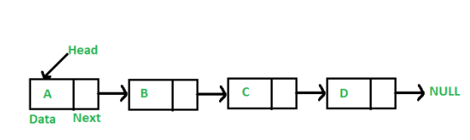
Linked List is a linear data structure. Unlike arrays, linked list elements are not stored at a contiguous location; the elements are linked using pointers.

Slide 4
Why Linked List?
Arrays can be used to store linear data of similar types, but arrays have the following limitations.
1) The size of the arrays is fixed:
2) Inserting a new element in an array of elements is expensive
Advantages over arrays 1) Dynamic size
2) Ease of insertion/deletion

Slide 5
Drawbacks: 1) Random access is not allowed.. 2) Extra memory space for a pointer is required with each element of the list. 3) Not cache friendly. Since array elements are contiguous locations, there is locality of reference which is not there in case of linked lists.

Slide 6
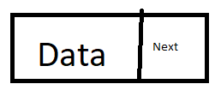
Representation
// A linked list node
struct Node {
int data;
struct Node* next;
} *start,*p,*q;

Slide 7
Operations on Linked List
1.Add First ( Insert at the Beginning )
2.Add End ( Insert at the End )
3.Add After ( Insert in between )
4.Display
5.Delete (at the Beginning, at the End, in between)
6. Search

Slide 8
Add beginning
addbeg(int n)
{
node *q;
q=new node; // malloc
q->link=start;
q->data=n;
start=q;
}

Slide 9
Add end
addend(int n)
{
node *q,*t;
if(q==NULL)
{
q=new node;
q->data=n;
q->link=NULL;
start=q
}
else
{
q=start;
while(q->link!=NULL)
q=q->link;
t=new node;
t->data=n;
t->link=NULL;
q->link=t;
}
}

Slide 11
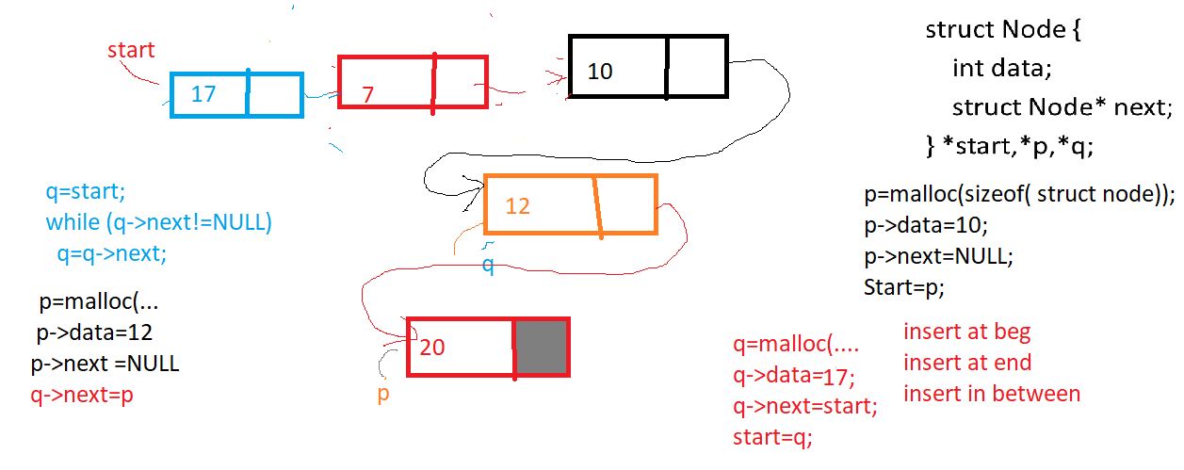

Slide 12
Add between/after
addafter(int c,int n)
{ node *q,*t;
int i;
for(i=0,q=start; i<c; i++)
{
q=q->link;
if(q==NULL)
{ cout<<“no index found to insert
elements";
return;
}
}
t=new node;
t->data=n;
t->link=q->link;
q->link=t;
}

Slide 13
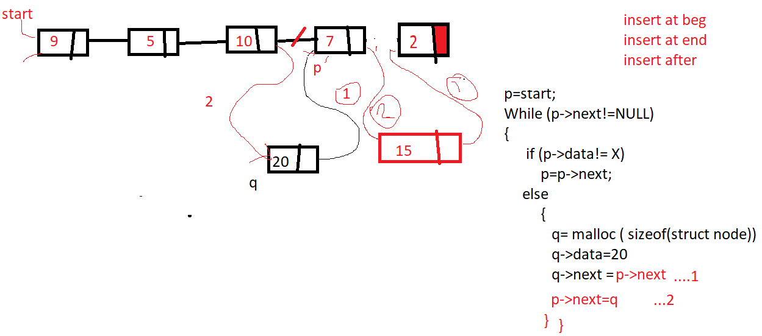

Slide 14
Display
listshow()
{
node *q;
for(q=Start;q!=NULL;q=q->link)
cout<<q->data;
}

Slide 15
Delete
Delete(int n)
{
node *q,*r;
q=start;
if(q->data==n)
{
start=q->link;
delete q; //BEGINNING
return;
}
else
{
r=q;
q=q->link;
while(q!=NULL)
{ if(q->data==n)
{ r->link=q->link;
delete q; // DEL AFTER
return;
}
else
{ r=q;
q=q->link;
}
} // while
} // else
cout<<"Element" <<n<< "is not in the list";
}

Slide 16
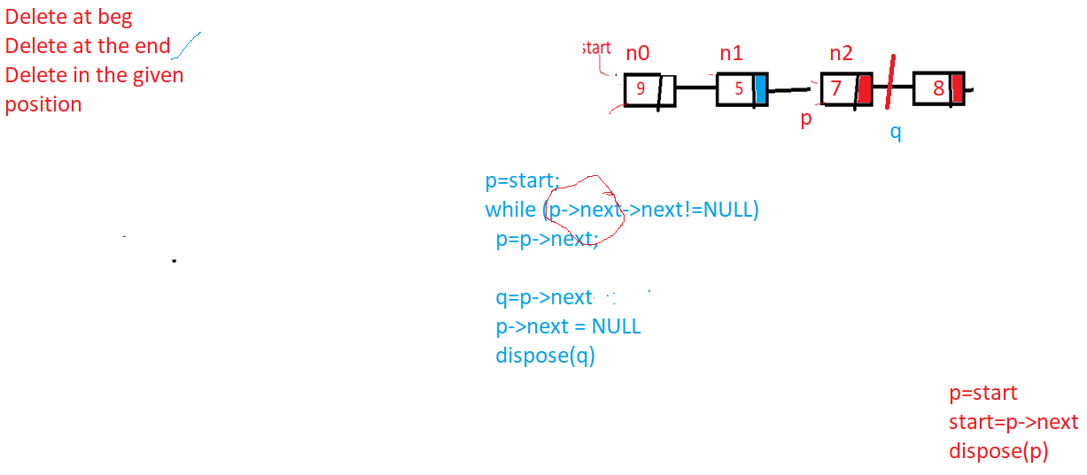

Slide 17
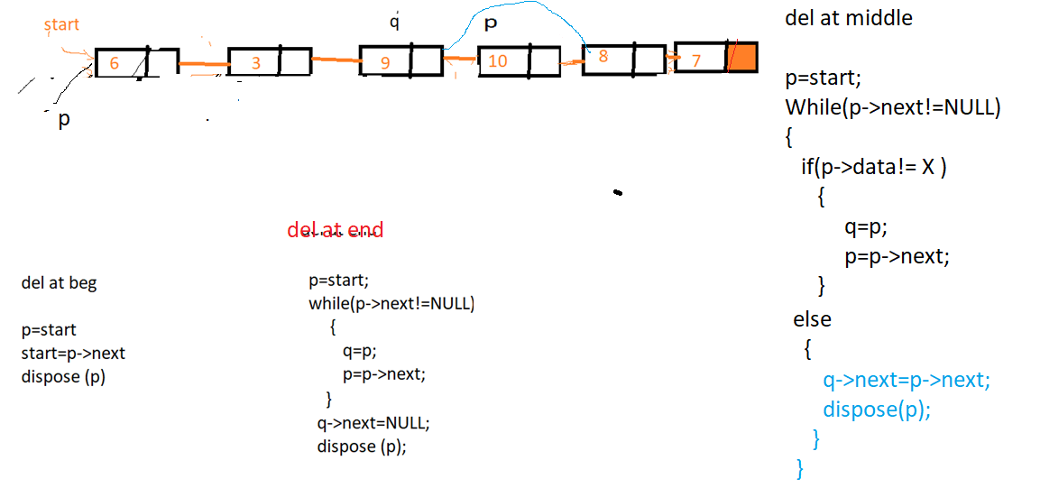

Slide 18
Searching
Listsearch()
{
node *q;
int x;
printf(“ enter the element to search”);
Scanf(“%d”,&x);
for(q=Start;q!=NULL;q=q->link)
if (q->data == x)
{ print (“ The element is found “);
return;
}
Prinf(“ The given number is not present in the list “);
}

Slide 19
Traversal
int main()
{
struct Node* head = NULL;
struct Node* second = NULL;
struct Node* third = NULL;
// allocate 3 nodes in the heap
head = (struct Node*)malloc(sizeof(struct Node));
second = (struct Node*)malloc(sizeof(struct Node));
third = (struct Node*)malloc(sizeof(struct Node));
head->data = 1; // assign data in first node
head->next = second; // Link first node with second
second->data = 2; // assign data to second node
second->next = third;
third->data = 3; // assign data to third node
third->next = NULL;
printList(head);
return 0;
}
struct Node {
int data;
struct Node* next;
};
// This function prints contents
// of linked list starting from
// the given node
void printList(struct Node* n)
{
while (n != NULL) {
printf(" %d ", n->data);
n = n->next;
}
}

Slide 20
Applications of linked list
Implementation of Stacks and Queues
Implementation of graphs : Adjacency list representation of graphs is most popular which is uses linked list to store adjacent vertices.
Dynamic memory allocation : We use linked list of free blocks.
Maintaining directory of names
Manipulation of polynomials by storing constants and coefficients in the node of linked list

Slide 21
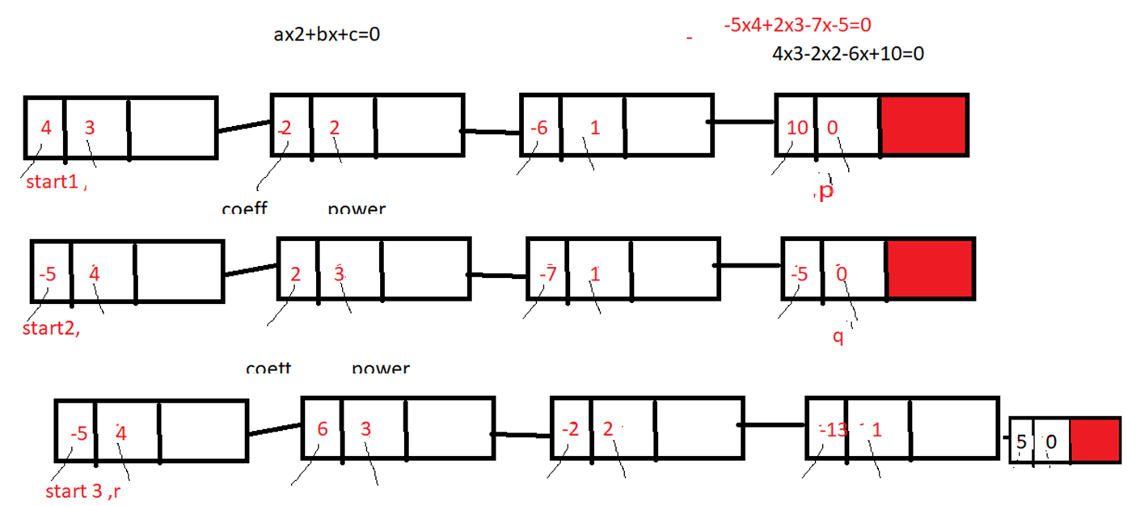
Polynomial addition

Slide 22
